Slide 1
SVM

Slide 2
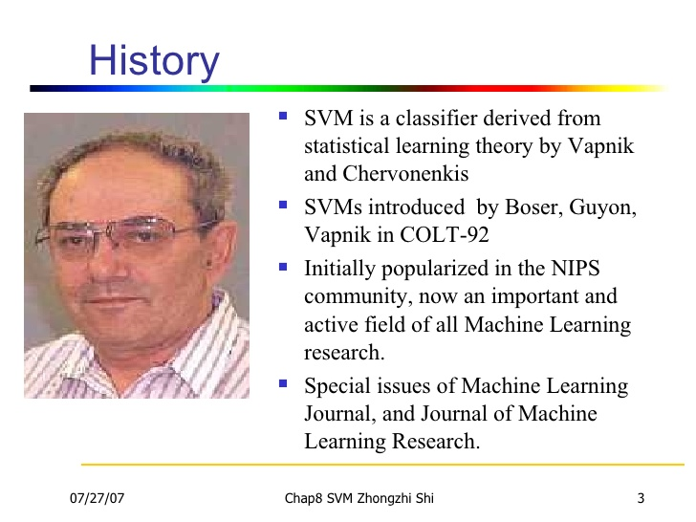

Slide 3
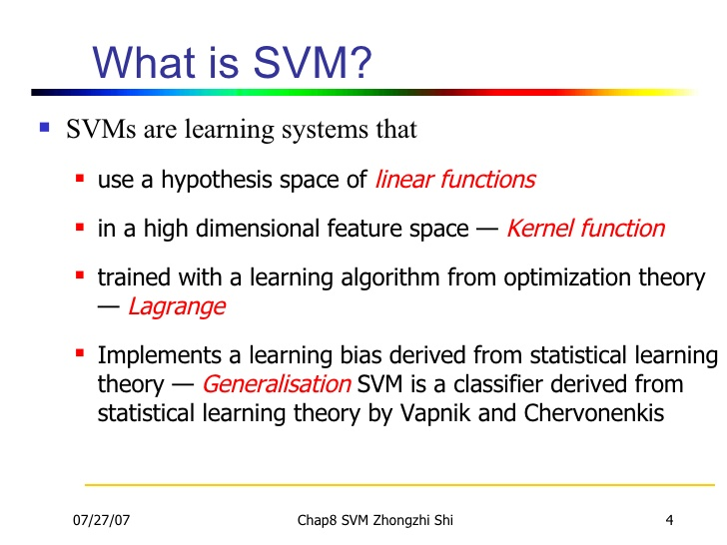

Slide 4
Binary Classification problem二元分類問題
Support Vector Machines
https://www.slideshare.net/nextlib/support-vector-machines

Slide 5
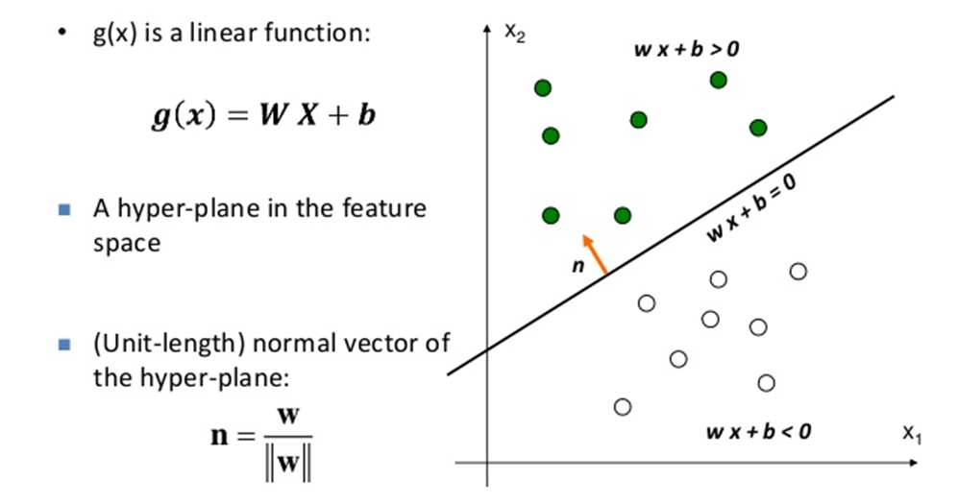
Support Vector Machine without tears
https://www.slideshare.net/ankitksharma/svm-37753690

Slide 6
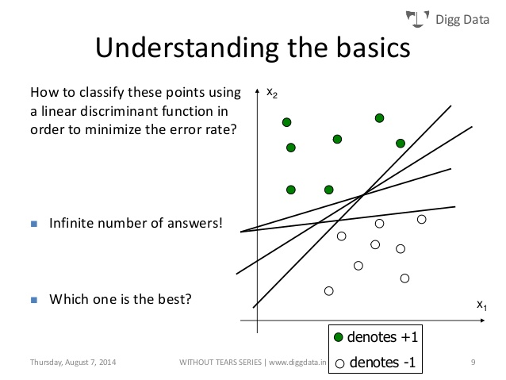
Support Vector Machine without tears
https://www.slideshare.net/ankitksharma/svm-37753690

Slide 7
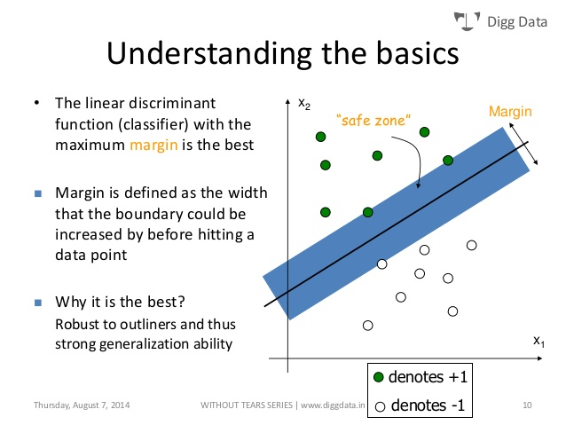

Slide 8
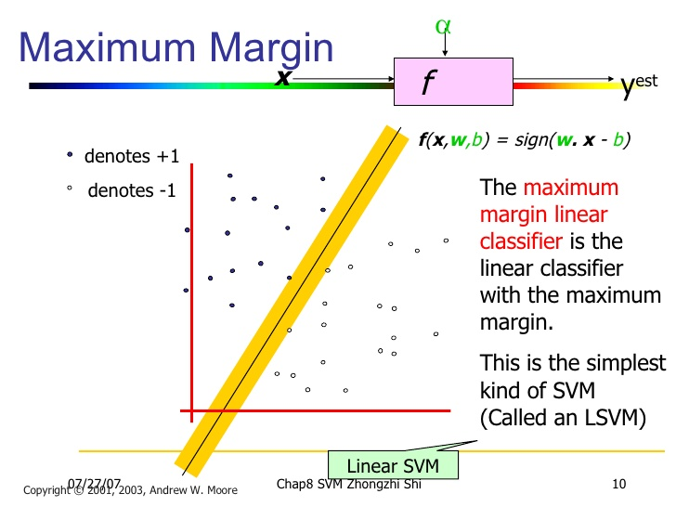
Support Vector Machines
https://www.slideshare.net/nextlib/support-vector-machines

Slide 9
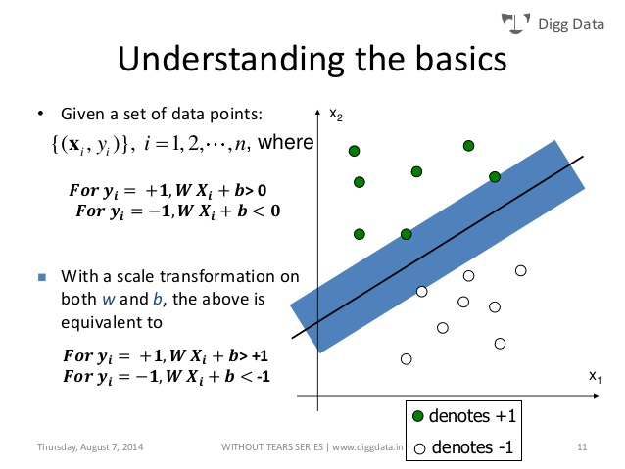

Slide 10
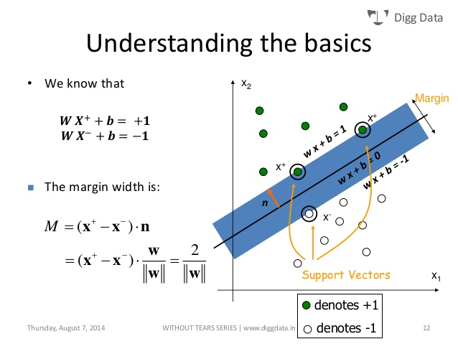

Slide 11
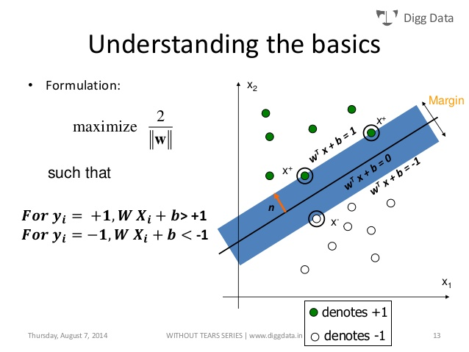

Slide 12
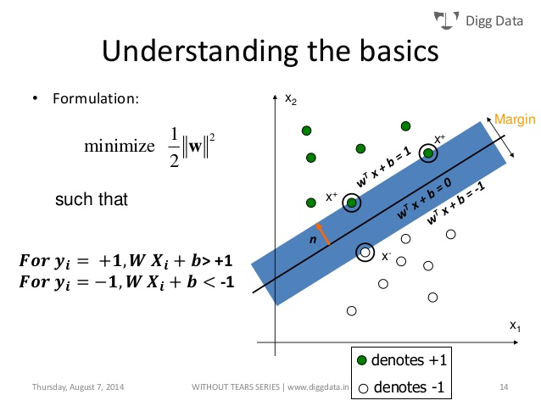

Slide 13


Slide 14
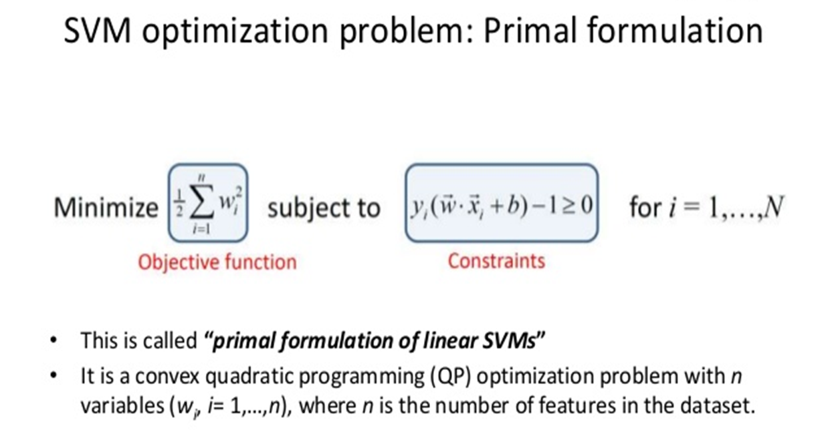

Slide 15
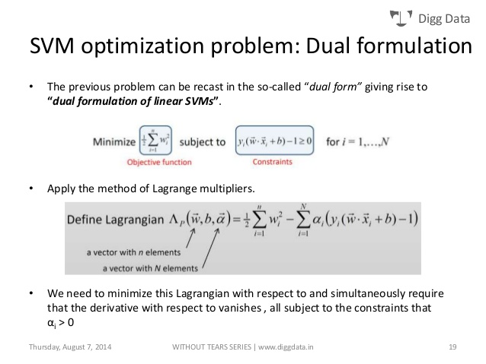

Slide 16
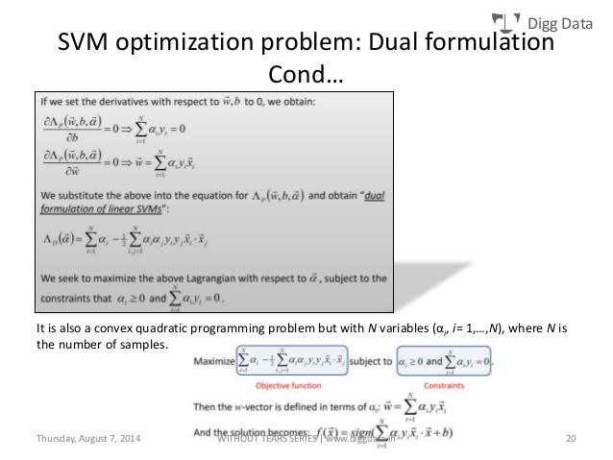

Slide 17
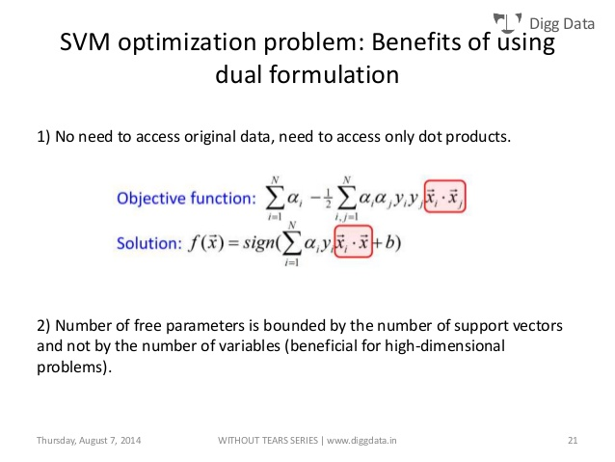

Slide 18
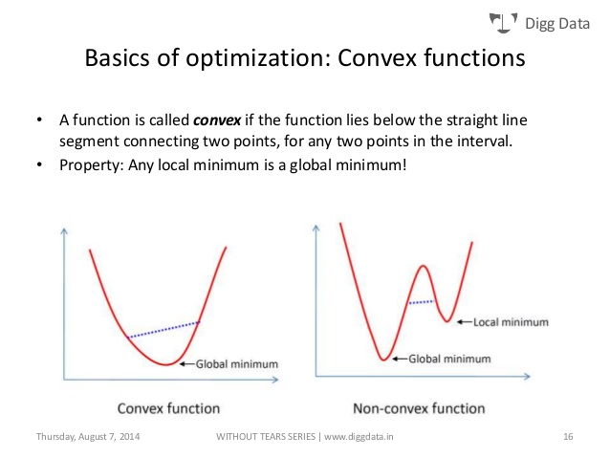

Slide 19
Hyperplane 超平面
Support Vector Machine without tears
https://www.slideshare.net/ankitksharma/svm-37753690

Slide 20
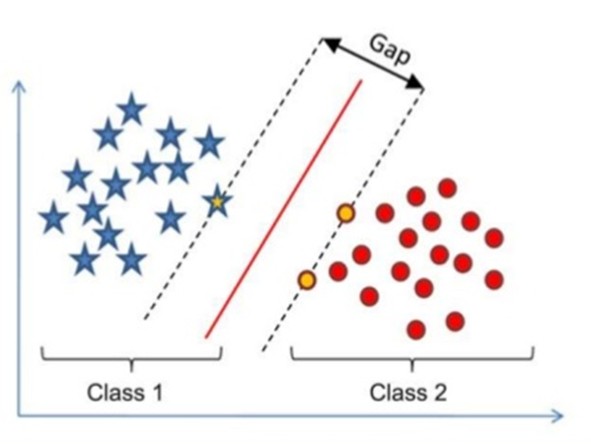
Support Vector Machine without tears
https://www.slideshare.net/ankitksharma/svm-37753690

Slide 21
Non-linear Classification
非線性問題

Slide 23
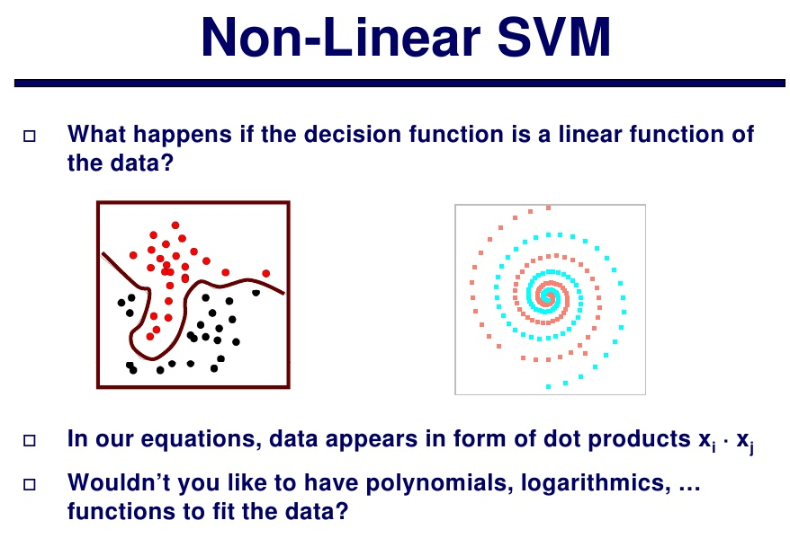
Lecture12 – SVM
https://www.slideshare.net/aorriols/lecture12-svm

Slide 24
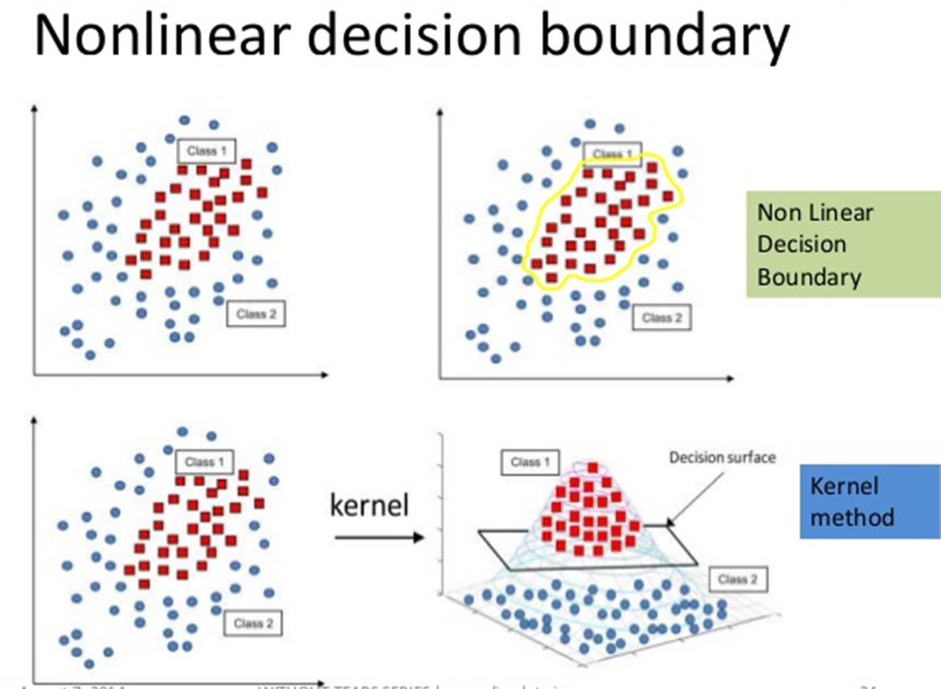
Support Vector Machine without tears
https://www.slideshare.net/ankitksharma/svm-37753690

Slide 26
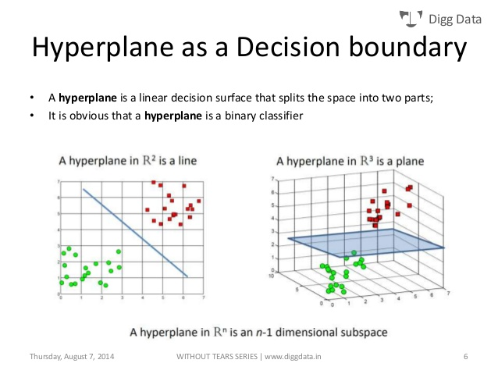
Support Vector Machine without tears
https://www.slideshare.net/ankitksharma/svm-37753690

Slide 27
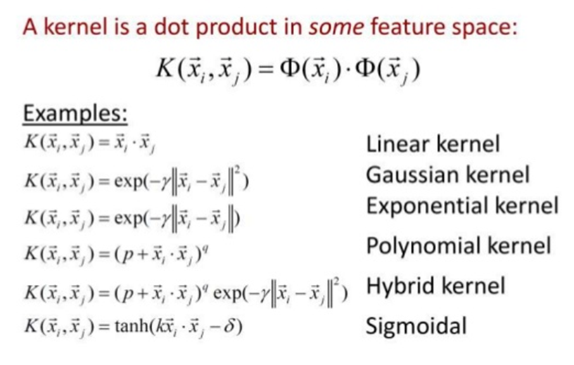

Slide 30
Sklearn_SVM

Slide 31
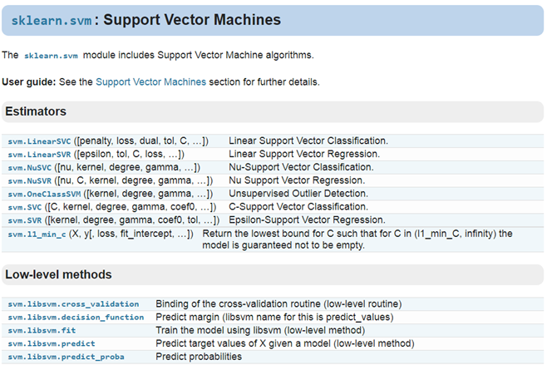
https://scikit-learn.org/stable/modules/classes.html

Slide 32
https://github.com/MyDearGreatTeacher/TensorSecurity/blob/master/data/iris.data
Sklearn_SVM_IRIS

Slide 33
https://github.com/MyDearGreatTeacher/TensorSecurity/blob/master/iris/Iris_scatter%E5%9C%96.md
import matplotlib.pyplot as plt
import numpy as np
from sklearn.datasets import load_iris #導入資料集iris
#載入資料集
iris = load_iris()
print(iris.data) #輸出資料集
print(iris.target) #輸出真實標籤
#獲取花卉兩列資料集
DD = iris.data
X = [x[0] for x in DD]
print(X)
Y = [x[1] for x in DD]
print(Y)
#plt.scatter(X, Y, c=iris.target, marker='x')
plt.scatter(X[:50], Y[:50], color='red', marker='o', label='setosa') #前50個樣本
plt.scatter(X[50:100], Y[50:100], color='blue', marker='x', label='versicolor') #中間50個
plt.scatter(X[100:], Y[100:],color='green', marker='+', label='Virginica') #後50個樣本
plt.legend(loc=2) #左上角
plt.show()

Slide 34
SVC_iris

Slide 35
from sklearn import svm
import numpy as np
import matplotlib.pyplot as plt
import matplotlib
import sklearn
from sklearn.model_selection import train_test_split

Slide 36
#define converts(字典)
def Iris_label(s):
it={b'Iris-setosa':0, b'Iris-versicolor':1, b'Iris-virginica':2 }
return it[s]

Slide 37
#1.讀取資料集
path='iris.data'
data=np.loadtxt(path, dtype=float, delimiter=',', converters={4:Iris_label} )
#converters={4:Iris_label}中“4”指的是第5列：將第5列的str轉化為label(number)
#print(data.shape)
#2.劃分資料與標籤
x,y=np.split(data,indices_or_sections=(4,),axis=1) #x為數據，y為標籤
x=x[:,0:2]
#sklearn.model_selection.
train_data,test_data,train_label,test_label =train_test_split(x,y, random_state=1, train_size=0.6,test_size=0.4)
#print(train_data.shape)

Slide 38
#3.訓練svm分類器
# ovr:一對多策略
classifier=svm.SVC(C=2,kernel='rbf',gamma=10,decision_function_shape='ovo')
#ravel函數在降維時預設是行序優先
classifier.fit(train_data,train_label.ravel())

Slide 39
#4.計算svc分類器的準確率
print("訓練集：",classifier.score(train_data,train_label))
print("測試集：",classifier.score(test_data,test_label))
#也可直接調用accuracy_score方法計算準確率
from sklearn.metrics import accuracy_score
tra_label=classifier.predict(train_data) #訓練集的預測標籤
tes_label=classifier.predict(test_data) #測試集的預測標籤
print("訓練集：", accuracy_score(train_label,tra_label) )
print("測試集：", accuracy_score(test_label,tes_label) )
#查看決策函數
print('train_decision_function:\n',classifier.decision_function(train_data)) # (90,3)
print('predict_result:\n',classifier.predict(train_data))

Slide 40
#5.繪製圖形
#確定坐標軸範圍
x1_min, x1_max=x[:,0].min(), x[:,0].max() #第0維特徵的範圍
x2_min, x2_max=x[:,1].min(), x[:,1].max() #第1維特徵的範圍

Slide 41
#生成網路採樣點
x1,x2=np.mgrid[x1_min:x1_max:200j, x2_min:x2_max:200j ]
grid_test=np.stack((x1.flat,x2.flat) ,axis=1) #測試點

Slide 42
#指定預設字體
matplotlib.rcParams['font.sans-serif']=['SimHei']
#設置顏色
cm_light=matplotlib.colors.ListedColormap(['#A0FFA0', '#FFA0A0', '#A0A0FF'])
cm_dark=matplotlib.colors.ListedColormap(['g','r','b'] )

Slide 43
# 預測分類值
grid_hat = classifier.predict(grid_test)
# 使之與輸入的形狀相同
grid_hat = grid_hat.reshape(x1.shape)

Slide 44
plt.pcolormesh(x1, x2, grid_hat, cmap=cm_light) # 預測值的顯示
plt.scatter(x[:, 0], x[:, 1], c=y[:,0], s=30,cmap=cm_dark) # 樣本
plt.scatter(test_data[:,0],test_data[:,1], c=test_label[:,0],s=30,edgecolors='k', zorder=2,cmap=cm_dark) #圈中測試集樣本點
plt.xlabel('花萼長度', fontsize=13)
plt.ylabel('花萼寬度', fontsize=13)
plt.xlim(x1_min,x1_max)
plt.ylim(x2_min,x2_max)
plt.title('鳶尾花SVM二特徵分類')
plt.show()

